Slide 1
Factorising with a common term

Slide 2
Factorise the following
6de – 18hd
-42d²mg + 72mdg²
4kp + 36k² -60kx
77b⁶e²h³ + 70be⁴h⁵ -105b⁶e²h⁷
27kh⁴d² + 72ad²h³ – 36g³h⁷d⁴
Notes:
Guided practice

Slide 3
Lesson objective
By the end of this lesson you will be able to;
- Identify common terms in binomials, and use these to factorise expressions.
Notes:
Lesson

Slide 4
24
7
30
Date
Common terms in binomials
EQ – How can we use common terms in binomials to solve problems?
A binomial is an expression with two terms.
When and expression has a common term, we can use it to simplify our working.
For example:
7(x+4) + 12(x+4) has a common term of (x+4)
Because this is a common term, both 7 and 12 are being distributed into these.
To solve this, we put the common term first
(x+4), then the two coefficients in a separate set of brackets (7+12), then write it as below;
(x+4)(7+12)
5
Notes:
Lesson objective (EQ)

Slide 5
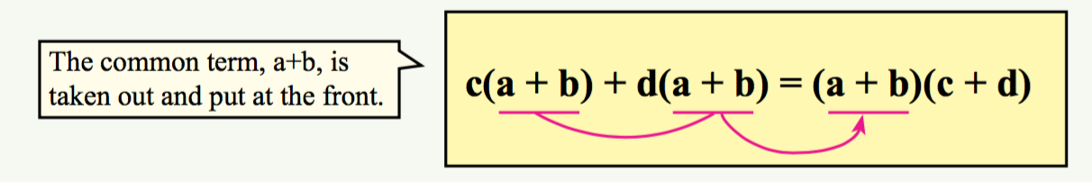
24
7
30
Common terms in binomials
EQ – How can we use common terms in binomials to solve problems?
Why does this work?
Lets look at a more in depth example:
7x(2x+4) + 2y(2x+4) – same as before, common term at the front
(2x+4) then the left overs second (7x+2y), write together;
(2x+4)(7x+2y)
Because of the common term, and that each of the front coefficients multiply the common term, we can simplify as above.
5

Slide 6
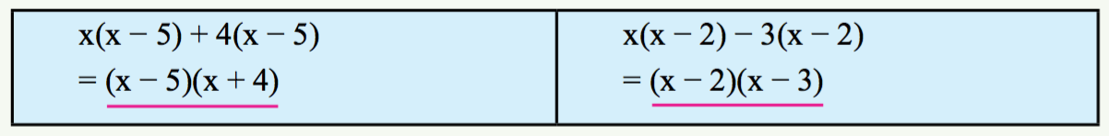
Guided Practice
1: 2(x+3) + y(x+3)
Put common term first – (x+3)(_ _ _)
Fill in the blanks- (x+3)(2 _ y)
Finally, the second operator is taken from in front of the 3, leaving us with the finished expression; (x+3)(2+y)
2: a(x+5) - 3(x+5) – identify common term – (x+5)
Put common term first – (x+5)(_ _ _)
Fill in the blanks- (x+5)(a _ 3)
Finally, the second operator is taken from in front of the 3, leaving us with the finished expression; (x+5)(a-3)
Notes:
Guided practice

Slide 7

Check for understanding
Notes:
Check for understanding

Slide 8
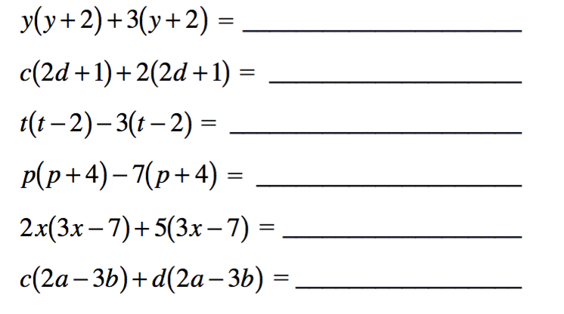
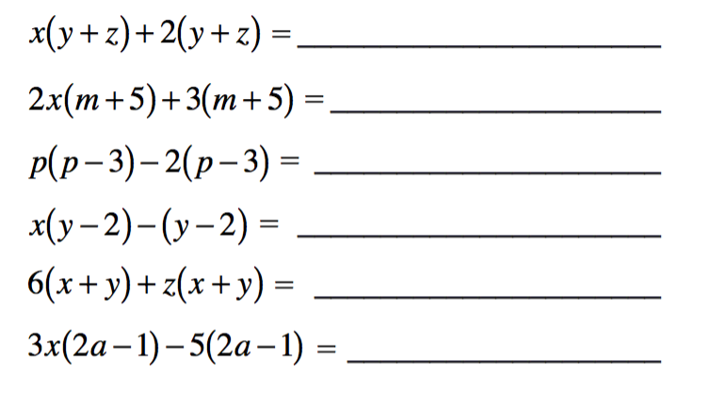
Activity
Factorise by removing the common term.
Notes:
Independent practice

Slide 9
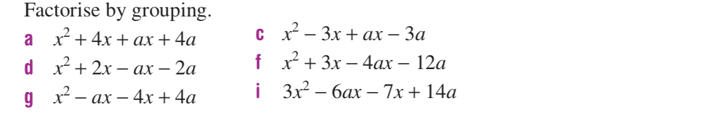
Factorising by Grouping
At times, our equations will not have a like term between them.
If we factorise pairs of terms, we can begin to see if there is a like term in our set.
Practise factorising the first and second term in the below set, then the third and fourth to see if they do share a like term.

Slide 10
Rearranging to factorise
At times, we will need to rearrange an equation to find a like term.
To do this, look at Coefficients OR Variables.
Remember- the operator in front of the term does not change.
Lets look at an example:

Slide 11
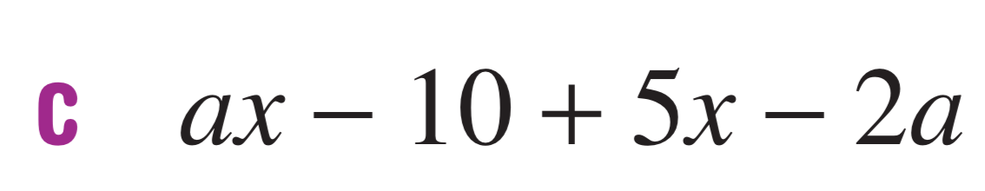
EXAMPLE: Rearranging
Looking at the variables, “ax” and “2a” share “a”, so rearrange the first two terms to read as “ax-2a”.
Factorising this leave us with a(x-2).
-10 +5x also share a factor of 5. If we remove this, we are left with 5(-2+x)…
Nope.
Lets rearrange them to +5x -10 – this becomes 5(x-2).
Now we have a(x-2)+5(x-2) – I see a like term.
Factorise it out to become (x-2)(a+5) ☺

